Slide 1





CAIP WINTER MEETING
Tort Claims Notice and Reacting to Injury Claims
Presenters:
Brett Gorman Teddy C. Strickland, Jr
Tuesday, January 27, 2026
10:00 a.m. – 11:30 a.m.

Slide 2

WELCOME
Jim Ridgway
CAIP Sub-fund Administrator
Vice President, J. Byrne Insurance

Slide 3

CONTINUING EDUCATION CREDITS
1 QPA CREDIT:
•1 Office Admin / General Duties
Certificates will only release at the end of the program and receipt of Completed Evaluation Form.
Must be present for the entire program.

Slide 4

NJSIG EXECUTIVE REPORT
Jill Deitch, Esq.
NJSIG Executive Director

Slide 5

NJSIG Updates
Joe Semptimphelter
NJSIG
Senior Business Development Specialist

Slide 6
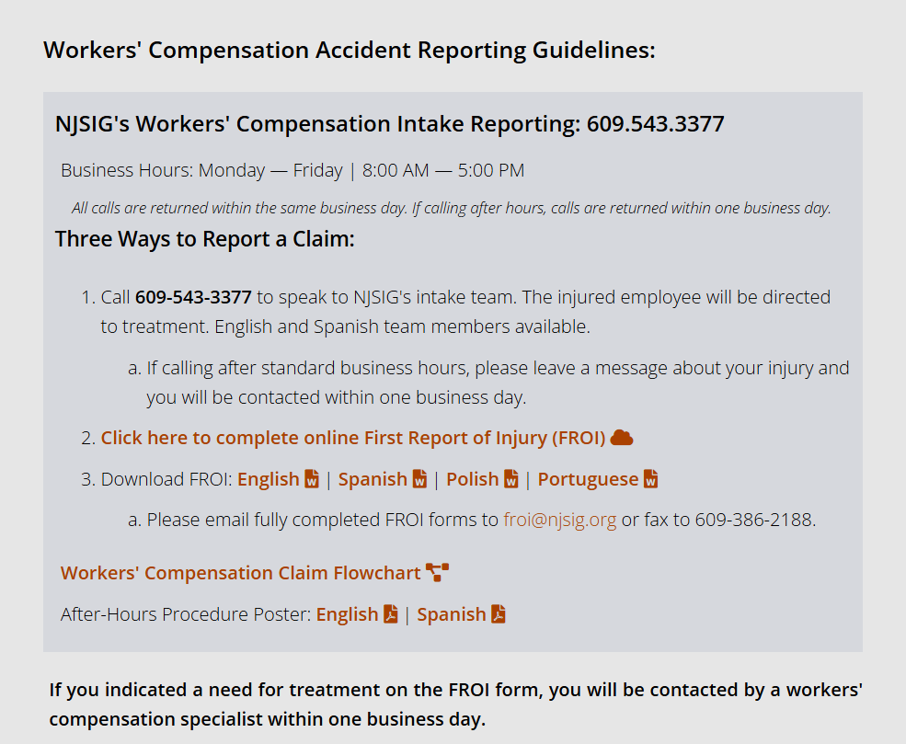
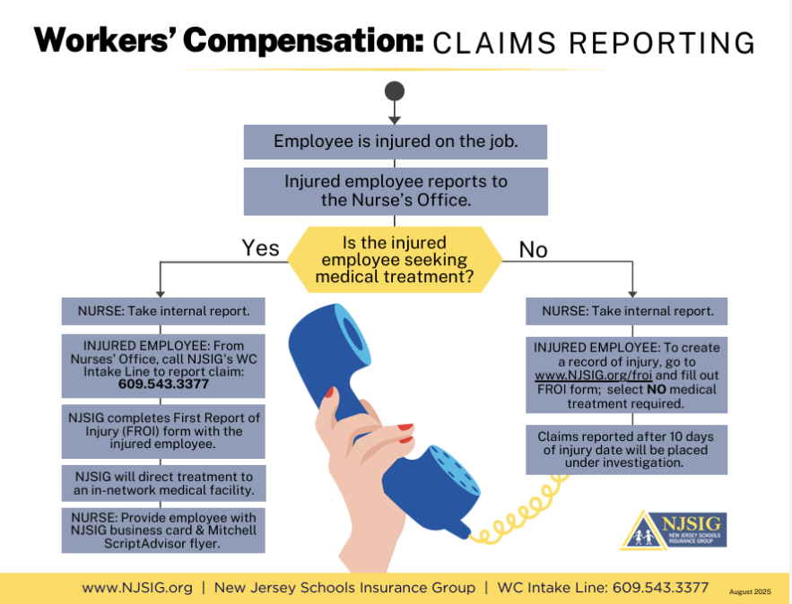
Worker’s Compensation
Claims Reporting Training
All materials can be found: https://www.njsig.org/reporting-claims#workerscomp

Slide 7


MEMBER SERVICE & PARTNERSHIP
MEMBER-CENTRIC SERVICE:
Training and Education:
Safety committees
Online & in-house training
Vector Solutions
Defensive driving training
Workers’ compensation training
Inspections:
Property: Every 5 years
Playground: Annual (by request)
NEW: Pre-QSAC Inspections!
Valuation Services / Appraisals:
Every 4 years via CBIZ

Slide 8
Tort Claims Notice
& Reacting to Injury Claims
Presenters:
Brett Gorman
Gorman, D’Anella, and Morlok LLC
Teddy C. Strickland, Jr., Esq.
Certified Civil Trial Attorney
Pender & Strickland Law

Slide 9

Tort Claims Act Requirements for Litigants Filing Claims Against Public Entities
Brett Gorman, Esquire
January, 2026

Slide 10

Sovereign Immunity
Public entities can be sued in tort, but only as the Tort Claims Act permits, and subject to specific statutory immunities and heightened standards.
The standard for liability under the TCA depends on whether the conduct of individuals acting on behalf of the public entity was ministerial or discretionary. See N.J.S.A. 59:2–3(d).
Notes:
Burnett v. County of Bergen decided in 2009
Balancing test between access to documents and citizen’s reasonable expectation of privacy weighed in favor of redacting SSNs.
Gilleran v. Township decided in 2016
OPRA’s security exclusion prevented disclosure of a full day of surveillance footage outside of town hall.
Brennan v. Bergen Cnty. Prosecutor’s Office decided in 2018
Balancing test weighed in favor of disclosure of names and addresses of bidders at a public auction
L.R. v Camden City Public Sch. Dist. decided in 2019
Creates a balancing test for a court to determine whether to order the production of student records under DOE regulations.
Bozzi v. City of Jersey City decided in 2021
Balancing test weighed in favor of disclosure of dog owners names and addresses contained in dog licensing records.

Slide 11
Ministerial v Discretionary
Ministerial: mandated by law or practice | Discretionary: decision making
Transportation staff securing wheelchair | Deciding whether to use one of two cafeteria aides for hallway coverage
Staff following anaphylaxis emergency plan | Deciding whether to consolidate bussing routes
Timely following through on work order marked “urgent” | Deciding which repairs to address first
Following procedure to check for and address icy conditions | Deciding whether to fund extra security
Doing “hall sweep” established by practice | Choosing temporary mitigation v immediate repair

Slide 12
Ministerial v Discretionary
Hytpothetical: In D.L. et. al. v. H.S. and S.S. o/b/o F.S. et al., a parent sued on behalf of his eighth grader who was struck in the face by a rock thrown by another student at recess claiming that there was insufficient supervision. The high school had 1,300 students and an open lunch policy in which students may leave campus. The supervision plan includes 3 teachers inside the cafeteria and 2 staff members outside. On Tuesdays, one of the outside staff is unavailable. No staff member is present in the area of the rock throwing. Staff are instructed to move outside as more students go outside after finishing lunch.

Slide 13
Ministerial v Discretionary
The Court held that the principal’s supervision decisions were discretionary decisions because:
“discretionary operational or less than high-level planning decisions made by a public employee charged with a duty to exercise more than a ministerial function may be granted immunity. However, it must be demonstrated that the employee's decision was made in the face of competing demands, involved whether or how to utilize or apply existing resources including those allocated to him for personnel, and his determination was not palpably unreasonable.”

Slide 14
Palpably Unreasonable
Palpably unreasonable” means behavior that is patently unacceptable under any given circumstance, and it must be manifest and obvious that no prudent person would approve of the course of action or inaction.
Palpably unreasonable is not simple negligence. It’s closer to so obviously wrong that no reasonable public administrator would do it.

Slide 15
Palpably Unreasonable
In D.L. et. al. v. H.S. and S.S. o/b/o F.S. et al., the Court remanded the case because the principal’s proofs that his decision was not palpably unreasonable was limited to the assertion that he had insufficient staff on Tuesdays. The Court held that sufficient proof would include
the actual number of his employees and where each was actually scheduled to be during the lunch periods
why it was necessary to grant one of the supervisory staff leave to attend an outside function on Tuesdays
why it was necessary for three teachers to be in the cafeteria as opposed to the use of two outside on Tuesdays
whether a teacher with the duty to patrol the halls could have been assigned outside
and whether it was reasonably possible to restrict some of the outside school areas to student use.
Notes:
MAG Entm't, LLC v. Div. of Alcoholic Beverage Control, 375 N.J.Super. 534, 543 (App.Div.2005).

Slide 16
Notice of Tort Claims
Under N.J.S.A. 59:8–8, a claimant must file a notice of claim upon a public entity or public employee “not later than the ninetieth day after accrual of the cause of action.” N.J.S.A. 59:8–8.
There are limited exceptions to the 90-day rule for reasons constituting extraordinary circumstances causing failure to file notice of claim for up to a year. N.J.S.A. 59:8–9.

Slide 17
Notice of Tort Claims
A public entity may by rule or regulation adopt forms specifying information to be contained in claims filed against it or its employee under this act. N.J.S.A. 59:8-6.
requirements serve the Legislature's objectives
to allow the public entity at least six months for administrative review with the opportunity to settle meritorious claims prior to the bringing of suit
to provide the public entity with prompt notification of a claim in order to adequately investigate the facts and prepare a defense
to afford the public entity a chance to correct the conditions or practices which gave rise to the claim
to inform the State in advance as to the indebtedness or liability that it may be expected to meet.
H.C. Equities, LP v. County of Union, 247 NJ 366, 383-84 (2021).

Slide 18
Required Information
The name and post office address of the claimant;
The post-office address claimant wants notices sent;
The date, place and other circumstances of the occurrence or transaction which gave rise to the claim asserted;
A general description of the injury, damage or loss incurred;
The name of the public entity or employee(s) causing injury; and
The amount claimed as of the date of presentation of the claim.

Slide 19
Optional Information
written reports of a claimant's attending physicians or dentists setting forth the nature and extent of injury and treatment, any degree of temporary or permanent disability, the prognosis, period of hospitalization, and any diminished earning capacity;
a list of claimant's expert witnesses and any of their reports or statements relating to the claim;
itemized bills for medical, dental, and hospital expenses incurred, or itemized receipts of payment for such expenses;
documentary evidence showing amounts of income lost;
if future treatment is necessary, a statement of anticipated expenses for each treatment.
submission to a physical or mental examination by a physician employed by the public entity;
Permission to inspect all appropriate records relating to claim for liability and damages including, but not limited to, income tax returns, hospital records, medical records and employment records.

Slide 20
Substantial Compliance with Notice Requirement
“[S]ubstantial compliance means that the notice has been given in a way, which though technically defective, substantially satisfies the purposes for which notices of claims are required.” H.C. Equities at 386.
Adopting a 59:8-6 form does not change the purpose of the TCA notice requirement, but it operationalizes it by requiring fuller early disclosure, and courts will enforce it. See Wood v. County of Burlington,
A court deciding a substantial compliance claim considers:
prejudice to the defending party;
steps taken to comply with the statute;
general compliance with the purpose of the statute;
reasonable notice of petitioner's claim, and
a reasonable explanation why there was not a strict compliance with the statute. Ibid.

Slide 21
Tort Claims Notice
Hypothetical: In Wood v. County of Burlington, a school district police department were involved in a serious incident and a student later dies. The family alleges excessive force and files a Tort Claims Act Notice within 90 days, describing the date, location, parties involved, and general nature of the claim. On the same day, the B.A. sends counsel the District’s official Notice of Claim form stating that the claim would not be considered filed until the form is completed and returned. The form demanded additional information. Plaintiffs refused to complete the District’s form and nine months later moved for an order declaring their initial notice legally sufficient, or alternatively for leave to file a late notice. 302 N.J.Super. 371 (App. Div. 1997).

Slide 22
Tort Claims Notice
The Court found that a public entity may adopt its own TCA notice form requiring information more detailed in N.J.S.A. 59:8-4 and the statute authorizes entities to specify what information must be provided to allow orderly, expedient administrative disposition of claims. Mere compliance with 59:8-4 is not enough where a public entity has adopted a valid 59:8-6 form. A claimant must substantially comply with the adopted form, because the form serves the same notice purposes. Because plaintiffs refused to complete the adopted form and did not provide damages information, they did not substantially comply with the notice requirements. Late notice relief was denied because plaintiffs failed to show “extraordinary circumstances”.
Notes:
MAG Entm't, LLC v. Div. of Alcoholic Beverage Control, 375 N.J.Super. 534, 543 (App.Div.2005).

Slide 23
Takeaways
Liability is the exception, not the rule: Public entities can be sued in tort, but only as the Tort Claims Act permits, and subject to statutory immunities and limitations.
The standard depends on whether the act was ministerial or discretionary.
“Palpably unreasonable” is a high bar, but you must be able to prove it. If challenged, the district should be able to show what staffing/resources existed, how they were deployed, and why decisions were made.
Tort Claims Notice is a fast deadline, only 90 days.
The TCA notice requirement is designed to give the public entity a fair chance to investigate early, evaluate financial exposure, consider settlement, and prepare a defense.
Substantial compliance is purpose-driven. Courts look at prejudice, steps taken to comply, whether the purpose was satisfied, and whether there is a reasonable explanation for defects.
If the district adopts a claim form, courts will enforce it. A district may adopt a form requiring more detail than N.J.S.A. 59:8-4 and a claimant must substantially comply with the adopted form, not just the baseline statute.

Slide 24
Reacting to Injury Claims:
Report to Insurance Carrier/Claims Handler;
Create the required reports;
There are important measures involving, and beyond an incident report.

Slide 25
Employees should not admit fault or volunteer conclusions.
Not because anything should be hidden, but because they may admit fault or other conclusions without fully understanding what is required for what they are admitting.

Slide 26
Collect details and information:
Using a slip and fall for example:
Footwear, substances on the floor (how it got there, how long was it there?), lighting conditions, etc.;
There are specific details that could determine liability in its entirety;
Those details may only be available for a short time.

Slide 27
Preserve evidence you control:
Photographs;
Video;
Witness identities and statements.

Slide 28
Spoliation – What is spoliation?
Spoliation of evidence in a prospective civil action occurs when a party destroys or fails to preserve evidence pertinent to the action. Aetna Life and Cas. Co. v. Imet Mason Contractors, 309 N.J. Super. 358, 364 (App. Div. 1998) (citing Hirsch v. General Motors Corp., 266 N.J. Super. 222, 234 (Law Div.1993).

Slide 29
When does a party have a duty to preserve evidence?
“A duty to preserve evidence, independent from a court order to preserve evidence arises where there is pending or probable litigation involving the defendants. There must be knowledge by the party of the existence or likelihood of litigation and foreseeability of harm to the opposing party, or in other words, discarding the evidence would be prejudicial . . . [and] the evidence must be relevant to the litigation.” Aetna Life and Cas. Co., 309 N.J. Super. at 361.

Slide 30
What happens if a Court finds evidence was spoliated?
“One remedy available to a litigant who has been prejudiced by intentional spoliation is a discovery sanction pursuant to Rule 4:23-2(b). Rosenblit v. Zimmerman, 166 N.J. 391, 402 (2001). This rule allows a court to "order that designated facts be taken as established, refuse to permit the disobedient party to support or oppose designated claims or defenses, prohibit the introduction of designated matters into evidence, dismiss an action, or enter judgment by default." Rosenblit, 166 N.J. at 402-03.

Slide 31
Courts take spoliation seriously:
A party who destroys evidence interferes with the ability to defend or prosecute a lawsuit and their right to discovery. Aetna Life and Cas. Co., 309 N.J. Super. at 364 (citing Hirsch, 266 N.J. Super. at 245.

Slide 32
A Court may give an adverse inference charge:
"The spoliation inference permits the jury to infer that the evidence destroyed or concealed would not have been favorable to the spoliator." Rosenblit, supra, 166 N.J. at 401-02;
It "serves the purpose 'of evening the playing field where evidence has been hidden or destroyed." Rosenblit, supra, 166 N.J. at 401.

Slide 33
Example of adverse interest:
“At the close of plaintiff's case, the court provided the following adverse inference charge:
You did hear some testimony from . . . plaintiff regarding a Ring doorbell video and that is relevant to the matter before you. . . . [P]laintiff has failed to maintain the video and therefore won't have it here for you.
Under these circumstances you have the right to infer that the video, had it been produced, would have been adverse to the interest of . . . plaintiff . . . .”
Gonter v. Dawson, 2025 N.J. Super. Unpub. LEXIS 1849, *9, 2025 LX 402607

Slide 34
Takeaways
Immediately report the incident to the insurance carrier / claims handler
Complete required internal documentation
Do not admit fault or volunteer conclusions because staff often don’t yet know all relevant facts
Collect key factual details quickly while evidence is fresh
Preserve evidence within the District’s control
Spoliation risk is real: destroying or failing to preserve relevant evidence can trigger sanctions
Duty to preserve evidence begins when litigation is pending or reasonably anticipated
Courts can impose serious consequences for spoliation
Bottom line: treat early evidence preservation like case defense preparation from day one

Slide 35
Thank you!
Teddy Strickland, Esquire Brett Gorman, Esquire
January 2026

Slide 36

Thank You
CAIP WINTER MEETING 2026

